Slide 1
Software Development Life Cycle(SDLC)
-Chandan Naresh
(Program Manager)

Slide 2
Agenda
Introduction
SDLC Overview
SDLC Phases
SDLC Model
Risk Management of SDLC project
Real World Examples
Agile Model
Agile in Projects
Conclusion

Slide 3
What is SDLC
process for planning, creating, testing, and deploying an information system

Slide 4

Aims & Objectives
Design, develop and test high quality software.
Match customer expectations.
Reaches completion within time and budget.

Slide 5
SDLC Phases
Gather & Understand the requirements
Create Various Prototypes and Designs while Planning
Start coding and create software/applications
Conduct various types of test to check for any
Deploy the software
Requirement gathering
Analyse ,Plan & Design
Deploy
Develop
Test

Slide 6
Implementation Success Journey
START
Analyze &Plan
Design & Develop
Qualify, Finalize scope , Cloud Orientation, Delivery Approach, Risk identification, Define success criteria
Solution and Architecture Design, Initial validation , Identify gaps
Validate &Test
Configure& Build
Train user for UAT, perform unit, system, end to end testing, performance, security , access
Functional, Technical , extensions, integration, reports and analytics, multiple iterations, develop solutions, fine tune
FINISH
Transition & GO LIVE (eXperience)
Sustain & Realize
Cutover, Transition to Cloud – Configuration, Data, Reports, Integration, Customization
Support GO LIVE
Hyper care, Monitor adoption,
Transition to support, Measure

Slide 7
Client Shares SOW
Vendor Understands the requirement
Prepare Project Plan
Design
Important Considerations
Software Overview
& expectation
Any technology specification
Sample Screens
Current Process
Expected Behavior
User Base
Expected Launch Period
Training Need
Maintenance Need
Breakdown the requirement
Analyse the modules
Functional & Technical requirements
Understand the workflow
User interaction
Identify Any APIs or Third-Party Application integration
Ask queries to client
Prepare Project Timeline
Create Milestones
Identify modules & tasks
Divide the work among team
Project Tracking
Project Plan Approval from Client
Create wireframe
Create sample screens
Create DB designs
Benefits
Ensures project schedule does not get impacted due to unavailability of resources or delays due to dependencies
Strong governance critical for project delivery. Helps in
keeping track of project schedules, risks and mitigations.
Managing cross-functional dependencies effectively.
Notes:
Talk about POC

Slide 8
Development
Testing
Software Release
Support & Maintenance
Important Considerations
Module wise or parallel development among team members
Divide DB, UI and Programming
Version Control
Create User Manuals
Create
Tracking Development
Create Test Plans
Code Review
Unit Testing
End User Testing
Record Test Results
Fix Bugs and Issues
Demo & Sign off from Client
Software Release V1
Sign off from Client
Change Management-
User Adoption
Support on bugs, UI, minor changes
Change Request for new features.
Benefits
Defined scope would help in managing delivery plan as per schedule.
Users understanding of
expected outcomes will help in smooth transition eliminating other non-implementation issues
which may get reported
Effective change management will help in right adoption and acceptance of new system by users
Regular Support & Maintenance will ensure
Smooth functioning of the software
Notes:
Talk about POC

Slide 9
SDLC Models
BigBang
Based on Time, Effort & Resource
Iterative
Feedback from every phase
Agile
Continous development and improvement
Incremental
Design, test and Implement incrementally
V-Model
Process steps forms a V shape
Spiral
Adopt elements from one or more process models
RAD
More emphasis on adaptive process
WaterFall
Breakdown of project activities into linear sequential phases

Slide 10
Big Bang Model
The Big bang model is an SDLC model does not require any planning. It is the simplest SDLC model. The budget and timeline requirement for Big Bang model projects are huge. The name big bang model was set after the “Great Big Bang” which led to the development of galaxies, stars, planets, etc.
In order to build a project , Big Bang model combines time, efforts, and resources. The result might not match the customer expectation due to lack of planning and improvements.
Big Bang Model
Time
Resource
Effort
Software Product
Release
Notes:
https://www.geeksforgeeks.org/overview-of-big-bang-model/
The product requirements are understood and implemented as they arrive. The complete modules or at least the part of the modules are integrated and tested. All the modules are run separately and the defective ones are removed to find the cause. It is a suitable model where requirements are not well understood and the final release date is not given. In simple, it can be phased out in 3 points i.e.
Integrate each individual’s modules to give a unique integrated overview
Test each module separately to identify any error or defects
If any error found then separate that module and identify the cause of the error
When to use it and where not to :
This SDLC model is suitable for small projects when few people are working on the project, the customer’s demands are not exact and keep changing, or if it is a dummy/side-project. As there is no proper planning in this model it is considered the worst SDLC model and is highly unsuitable for large projects.
It is recommended to go for the Big Bang model only due to the following cases i.e.
Developing a project for learning purposes or experiment purposes.
No clarity on the requirements from the user side.
When newer requirements need to be implemented immediately.
Changing requirements based on the current developing product outcome.
No strict guideline on product release or delivery date.
Features of Big Bang Model :
Not require a well-documented requirement specification
Provides a quick overview of the prototype
Needs little effort and the idea of implementation
Allows merging of newer technologies to see the changes and adaptability
Pros of Big Bang Model :
There is no planning required for this.
Suitable for small projects
Very few resources are required.
As there is no proper planning hence it does not require managerial staffs
Easy to implement
It develops the skills of the newcomers
Very much flexible for the developers working on it
Cons of Big Bang Model :
Not suitable for large projects.
Highly risky model and uncertain
Might be expensive if requirements are not clear
Poor model for ongoing projects
Conclusion :
The big bang model is a very simple SDLC model that is suitable for small projects for learning or a side project without much planning. It is too simple, but it is risky for large projects involving lots of complicated and would require the involved people to be well-trained in the technology on which the project is based.

Slide 11
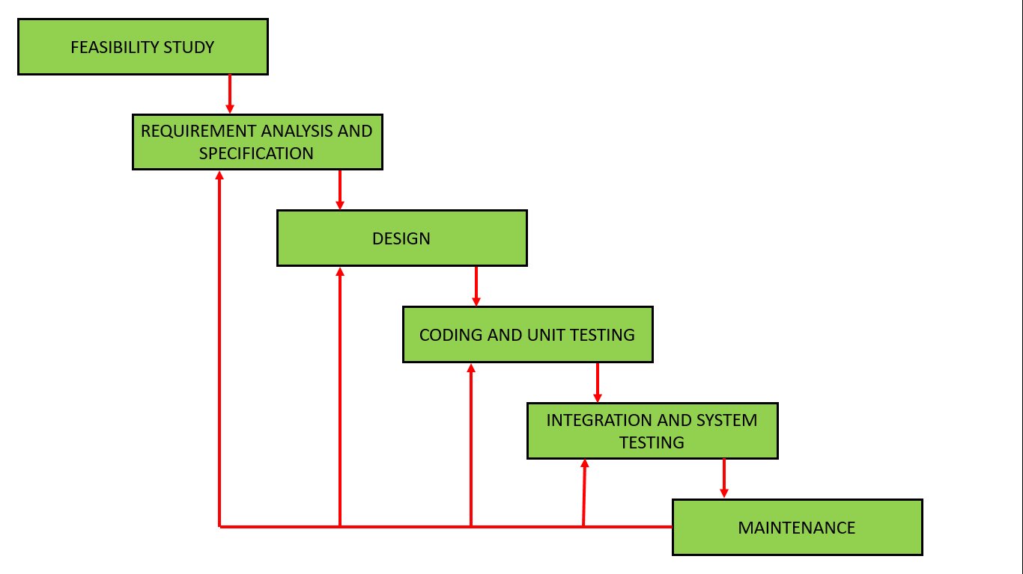
Iterative Model
The iterative waterfall model provides feedback paths from every phase to its preceding phases. This is the main difference from the classical waterfall model
Feedback paths allow correcting errors
committed by programmers during
any of the phase.
Pros:
Possible defects are spotted and dealt
early
Functional prototypes are developed
early in the project life cycle
Less time is spent on documenting and
more on designing
Cons:
Intensive project management with more
resources may be required
lack of a full requirements specification
for the entire system
Notes:
Ideal scenarios for Iterative Development
There are some scenarios that are particularly well suited to this type of development:
Clear, comprehensive requirements have been defined
Major requirements are defined at the onset, but some functionality may evolve over time in collaboration with the client
Time-to-market is a constraining element in the project
Innovative technology is involved – and being learnt by the development team as they work
Goals are subject to change over time

Slide 12
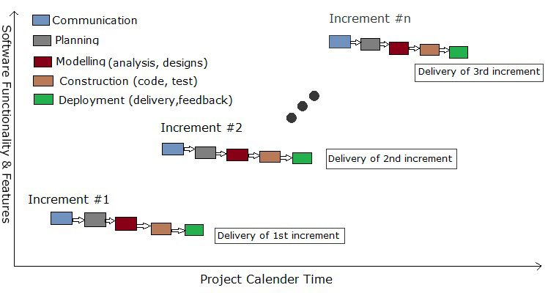
Incremental Model
The product is designed, implemented and tested incrementally (a little more is added each time) until the product is finished. It involves both development and maintenance
The product is defined as finished
when it satisfies all of its requirements.
This model combines the elements of
the waterfall model with the iterative
philosophy of prototyping.
Pros:
Initial Delivery cost is less
Easy risk management as risks are
identified in every increment
Cons:
Cost is higher than waterfall model

Slide 13
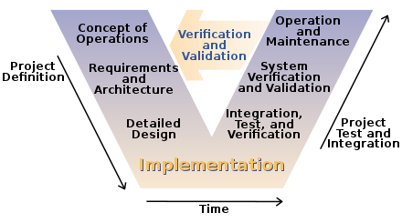
V Model
Extension of the waterfall model. Instead of moving down in a linear way, the process steps are bent upwards after the coding phase, to form the typical V shape.
The V-Model demonstrates the relationships between each phase of the development life cycle and its associated phase of testing.
Pros:
Suitable for small and medium projects
Ambiguities are identified from the beginning because of testing from the initial phase.
Cons:
Not suitable if requirement is not fixed
Ready product is not produced in intermediate stages

Slide 14
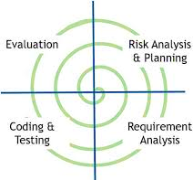
Spiral Model
A risk-driven software development process model. Based on the unique risk patterns of a given project, the spiral model guides a team to adopt elements of one or more process models, such as incremental, waterfall, or evolutionary prototyping.
Perform four basic activities in every cycle
Consider the win conditions of all success-critical stakeholders.
Identify and evaluate alternative approaches for satisfying the win conditions.
Identify and resolve risks that stem from the selected approach(es).
Obtain approval from all success-critical stakeholders, plus commitment to pursue the next cycle.
Notes:
When to use Spiral Model?
A Spiral model in software engineering is used when project is large
When releases are required to be frequent, spiral methodology is used
When creation of a prototype is applicable
When risk and costs evaluation is important
Spiral methodology is useful for medium to high-risk projects
When requirements are unclear and complex, Spiral model in SDLC is useful
When changes may require at any time
When long term project commitment is not feasible due to changes in economic priorities
Pros:
Flexibility allows incorporation of future changes
Continuous or repeated development helps in risk management
Development is fast and features are added in a systematic way in Spiral development
Cons:
Documentation is more as it has intermediate phases
not advisable for smaller project, it might cost them a lot

Slide 15
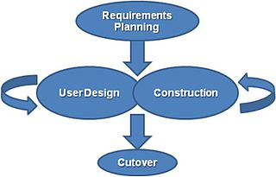
RAD Model
Rapid Application Development put less emphasis on planning and more emphasis on an adaptive process. Prototypes are often used in addition to or sometimes even instead of design specifications.
Well suited for developing software that is driven by user interface requirements. Graphical user interface builders are often called rapid application development tools.
Pros:
Better Quality product
Better Risk Control
Better time and budget control
Cons:
Less emphasis on Non-Functional Requirement
Not good for Large projects as it focuses more on small- medium scale projects
Notes:
The James Martin approach to RAD divides the process into four distinct phases:
Requirements planning phase – combines elements of the system planning and systems analysis phases of the Systems Development Life Cycle (SDLC). Users, managers, and IT staff members discuss and agree on business needs, project scope, constraints, and system requirements. It ends when the team agrees on the key issues and obtains management authorization to continue.
User design phase – during this phase, users interact with systems analysts and develop models and prototypes that represent all system processes, inputs, and outputs. The RAD groups or subgroups typically use a combination of Joint Application Development (JAD) techniques and CASE tools to translate user needs into working models. User Design is a continuous interactive process that allows users to understand, modify, and eventually approve a working model of the system that meets their needs.
Construction phase – focuses on program and application development task similar to the SDLC. In RAD, however, users continue to participate and can still suggest changes or improvements as actual screens or reports are developed. Its tasks are programming and application development, coding, unit-integration and system testing.
Cutover phase – resembles the final tasks in the SDLC implementation phase, including data conversion, testing, changeover to the new system, and user training. Compared with traditional methods, the entire process is compressed. As a result, the new system is built, delivered, and placed in operation much sooner.^{[7]}

Slide 16
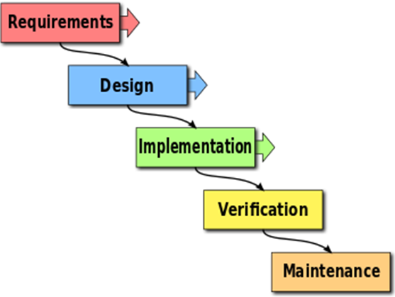
Waterfall Model
Breakdown of project activities into linear sequential phases, where each phase depends on the deliverables of the previous one and corresponds to a specialization of tasks.
Pros:
End Goal is known early
Transforms complete info from one phase to another.
Cons:
Less emphasis on Non-Functional Requirement
Not good for Large projects as it focuses more on small- medium scale projects
Notes:
The James Martin approach to RAD divides the process into four distinct phases:
Requirements planning phase – combines elements of the system planning and systems analysis phases of the Systems Development Life Cycle (SDLC). Users, managers, and IT staff members discuss and agree on business needs, project scope, constraints, and system requirements. It ends when the team agrees on the key issues and obtains management authorization to continue.
User design phase – during this phase, users interact with systems analysts and develop models and prototypes that represent all system processes, inputs, and outputs. The RAD groups or subgroups typically use a combination of Joint Application Development (JAD) techniques and CASE tools to translate user needs into working models. User Design is a continuous interactive process that allows users to understand, modify, and eventually approve a working model of the system that meets their needs.
Construction phase – focuses on program and application development task similar to the SDLC. In RAD, however, users continue to participate and can still suggest changes or improvements as actual screens or reports are developed. Its tasks are programming and application development, coding, unit-integration and system testing.
Cutover phase – resembles the final tasks in the SDLC implementation phase, including data conversion, testing, changeover to the new system, and user training. Compared with traditional methods, the entire process is compressed. As a result, the new system is built, delivered, and placed in operation much sooner.^{[7]}

Slide 17
Important Considerations while Project Planning
Project Goals – Project Charter
Project Scope
Milestone & Major Deliverables
Work Breakdown Structure
Budget
Human Resource Plan
Risk Management Plan
Communication Plan
Stakeholder Management
Change Management
Notes:
10 Critical Steps to Include in a Project Plan
BY MICHAEL ROBERTS https://www.thebalancecareers.com/what-needs-to-be-in-a-project-plan-1669741
A project plan is the culmination of meticulous planning by a project manager. It is the master document that guides how a project will run, according to the manager’s intentions for each key facet of the project. Although project plans differ from company to company, there are ten critical elements or steps that should be included in an effective project plan to avoid confusion and forced improvisation during the project execution phase.
Project Goals
Marc Romanelli / Getty Images Project goals are defined in a project charter, but they should be included in the project plan as well to further explain the goals of the project or to include the charter as an appendix. No matter how a project manager chooses to incorporate the goals into the project plan, the important thing is to maintain a clear link between the project charter—a project’s first key document—and the project’s second key document, its project plan.
Project Scope
Like project goals, ​the scope is defined in the charter and should be further refined in the project plan by the project manager. By defining the scope, the project manager can begin to show what the project's goal or finished product will look like at the end. If the scope isn't defined, it can get expanded throughout the project and lead to cost overruns and missed deadlines.
For example, if you're leading a marketing team to create a brochure for a company's product line, you should denote how many pages will it be and provide examples of how the finished product might look.
For some team members, a brochure might mean two pages, while others might consider ten pages to be adequate. Defining the scope can get the entire team on the same page at the onset.
Milestones and Major Deliverables
The key achievements for a project are called milestones and the key work products are called major deliverables. They both represent the big components of work on a project. A project plan should identify these items, define them, and set deadlines for their completion.
If an organization undertakes a project to develop new software, major deliverables could be the final list of business requirements and how to implement them.
Following those, the project could have milestones for design completion, system testing, user acceptance testing, and the software rollout date. These milestones have work products associated with them, but they are more about the processes than the products themselves.
Milestone and major deliverable deadlines do not have to be exact dates, but the more precise, the better. Precise dates help project managers break down work structures more accurately.
In this stage of the plan, you'll be creating milestones so that you can take large or high-level deliverables and break them down into small deliverables, which can be outlined in the next step.
Work Breakdown Structure
A work breakdown structure (WBS) deconstructs the milestones and major deliverables in a project into smaller chunks so one person can be assigned responsibility for each facet. In developing the work breakdown structure, the project manager considers many factors such as the strengths and weaknesses of project team members, the interdependencies among tasks, available resources, and the overall project deadline.
Project managers are ultimately responsible for the success of the project, but they cannot do the work alone. The WBS is a tool the project manager uses to ensure accountability on the project because it tells the project sponsor, project team members, and stakeholders who are responsible for what. If the project manager is concerned about a task, they know exactly who to meet with regarding that concern.
Budget
A project’s budget shows how much money is allocated to complete the project. The project manager is responsible for dispersing these resources appropriately. For a project that has vendors, the project manager ensures deliverables are completed according to contract terms, paying particular attention to quality. Some project budgets link to the human resources plan.
It's important to establish the cost for each milestone and deliverable by looking at how much time is required, and the labor cost involved to complete the tasks. The cost of the project is tied to how long the project takes, which goes back to the scope of the project. The scope, milestones, tasks, and budget must be aligned and realistic.
Human Resources Plan
The human resources plan shows how the project will be staffed. Sometimes known as the staffing plan, the HR plan defines who will be on the project team and how much of a time commitment each person is expected to make. In developing this plan, the project manager negotiates with team members and their supervisors on how much time each team member can devote to the project. If additional staff is needed to consult on the project but are is part of the project team, that also is documented in the staffing plan. Again, appropriate supervisors are consulted.
Risk Management Plan
Many things can go wrong on a project. While anticipating every possible disaster or minor hiccup is challenging, many pitfalls can be predicted. In the risk management plan, the project manager identifies risks to the project, the likelihood those scenarios will happen, and strategies to mitigate them. To formulate this plan, the project manager seeks input from the project sponsor, project team, stakeholders, and internal experts.
Mitigation strategies are put into place for risks that are likely to occur or have high costs associated with them. Risks that are unlikely to occur and ones that have low costs are noted in the plan, even though they don’t have mitigation strategies.
Communications Plan
A communications plan outlines how a project will be communicated to various audiences. Much like the work breakdown structure, a communications plan assigns responsibility for completing each component to a project team member.
In this step, it's important to outline how issues will be communicated and resolved within the team and how often communication will be done to the team and the stakeholders or the boss. Each message has an intended audience. A communications plan helps project managers ensure the right information gets to the right people at the right time.
Stakeholder Management Plan
A stakeholder management plan identifies how stakeholders will be used in the project. Sometimes stakeholders only need to receive information. That can be taken care of in the communications plan. If more is needed from stakeholders, a stakeholder management plan outlines how it will be obtained.
Change Management Plan
A change management plan lays out a framework for making changes to the project. Although project managers tend to want to avoid changes to the project, they are sometimes unavoidable. The change management plan provides protocols and processes for making changes. It is critical for accountability and transparency that project sponsors, project managers, and project team members follow the change management plan.

Slide 18
Risk Management approach
Overall Implementation Risks
Availability of necessary Customer Business and IT SMEs given another parallel project in-flight
Ability of legacy systems to integrate and consume the cleansed Master Data from Item Master
Ability for legacy system to provide cleansed transaction data like Backlogs, contracts, pricelist etc.
Active Participation of and necessary support from Client/ Implementation Success Managers and Client Strategy and Product Owner team.
Availability and Quality of in-scope Master Data from legacy systems, to be determined through data profiling
Communication, Collaboration, and timely Decision Making to keep the project on track
Performance of applications
Bugs in applications, alignment of patching cycles
Risk Identification
Risk Management
Continuous Monitoring
Risk Analysis
Identify & Document Risks
Identify the potential risks that can impact Cost, Project Schedules or Continuity of Service during various phases of the project starting from initiation. Each potential risk will be assessed to determine the likelihood of occurrence and the effect on program success
Perform Risk Impact Analysis
Each potential risk will be assessed to determine the likelihood (high, medium, low) of becoming “real” and the effect it might have on success (high, medium, low).
Implement a Risk Management Plan
Engage with development PMO
Engage with Product Onwer
Monitor & Update Risk Tracker
Continue to monitor the identified risks across the entire program, and keep identifying the various points of possible failure. Risk Management Plan and Active Risk Register will be refined accordingly

Slide 19
Customer Team Role Expectations
Customer Project Manager
Responsible for overall project delivery and facilitation of required infra/access for implementation team
Governance of project and coordination with all required stakeholders
Weekly status updates from Implementation team , updates to management
Customer IT
IT Expert of the current system architecture related to the track
IT Expert guiding the integration requirements for the proposed solution related to the track
IT Expert guiding the data conversion strategy and its execution related to the track
IT Expert prioritizing the development objects related to the track
Steering Committee
Establish business vision and expectations
Overall Project governance and facilitation
Participate in executive requirement sessions
Business SME
Validate Overall fit and ease of adoption of the proposed solution
Ensure user training and adoption of proposed solution
Ensure and Prioritization of key requirements to align with the Project goals
Manage cross track conflicting requirements and resolve the same
Manage the core key business leads for testing cycles and user training
Validate the overall readiness for the go live process
Manage business risks and mitigations during all the phases of the project life cycle

Slide 20
Documents involved in SDLC
Sr | Document Name | Description
1 | Project Timeline and Milestones | This document will highlight the timelines and milestone at each stage of the project.
2 | Project Schedule | This document will contain the project schedule to be executed
3 | Project Charter | This document will contain the details of the project goals and objective
4 | Project Assumptions | This document will lay down all the project related assumptions
5 | Deliverable Approval Matrix | This document will contain the matric for delivery approval
6 | Milestone Acceptance Certificate | This certificate will be shared to the client when each milestone is completed for their acceptance.
7 | Change Management Assessment Deliverable and Communication Plan | This document will contain all the details for completed the change management assessment and how will the change be communicated to the Client’s users.
8 | Configuration Requirements | This document will contain all the requirements related to each configuration.
9 | Conversion Strategy Plan | This document will contain a strategy to undertake the data conversion smoothly.
10 | Integration Strategy Plan | This document will contain the strategy to integrate various third-party tools and applications

Slide 21
Documents involved in SDLC
Sr | Document Name | Description
11 | Operations Manual | This document will contain the details of how to operate the entire system step by step.
12 | Integration Strategy Plan and Interface Design Scope | This document will contain the design scope for interfaces developed and how to integrate them
13 | Reporting architecture model | The document will contain details of the reporting model
14 | System Security Plan | This document will contain a plan for system security
15 | Templates for functional and technical specification | This document will contain various templates for functional and technical specification
16 | End User Training Plan | This document will contain plan for end-user training
17 | Production Support Plan | This document will contain detail of how the production support will be given
18 | Technical Specifications Documents | These documents will contain technical specifications of all modules
19 | Test Scripts | This document will contain all test scripts
20 | Production Cutover plan | This document will contain the plan for production cut over

Slide 22
Documents involved in SDLC
Sr | Document Name | Description
21 | Data Conversion Plan | This document will contain the details for data conversion
22 | RTM (Requirement Traceability Matrix) | This document will be prepared before the project starts. It will describe the scope of the software system to be developed.
23 | System Administration Guide | This document will contain relevant information regarding the deployment, configuration, and administration of the software system.
24 | User Guide | This document, or manual is intended to assist to the Client staff using the new ERP system. It will help non-technical people pinpoint and solve problems without expert assistance.
25 | Developers Guide | This guide is intended to be a one-stop source for the developers for referring to the details of the developed application. This will be for the internal use of the Client as a handover if there is replacement or unavailability of certain developers.
26 | Technical Guide/Manuals | This document will help the end-user to understand the work dynamics and architecture of the new system. It will contain information on How to use, Common issues, how to troubleshoot, etc.
27 | Business Functionality Guide | This document will explain the Business Functionality and features of the Software System.
28 | Test Plans | This document will detail the objectives, resources, and processes for all test cases for the implementation.
29 | Training Documentation | This will contain- Reference materials, handouts, code snippets, scripts, manuals, slides, feedback forms etc. to Assist during and after the training.
30 | Desktop procedures | This will be used by the system users for their daily, monthly and yearly tasks.

Slide 23
Implementing SDLC in Real World
Learning Management System – Mobile client for students – Vinit’s Team , Amit’s Team
Online Food Ordering System - Rachit’s Team
Realtime Enterprise Communication App – Alekhya’s Team
Enterprise Social Media App - Yash’s Team
Path Lab App – Saurav Team
School Admin App – Gagan Team
Notes:
Ask students the phases of SDLC and how the project can be divided

Slide 24

Agile based Development

Slide 25
Agile Development
What is Agile
In software development, agile practices involve discovering requirements and developing solutions through the collaborative effort of self-organizing and cross-functional teams and their customer/end user…. Wikipedia
Agile is an iterative approach to project management and software development that helps teams deliver value to their customers faster and with fewer headaches. Instead of betting everything on a "big bang" launch, an agile team delivers work in small, but consumable, increments. Requirements, plans, and results are evaluated continuously so teams have a natural mechanism for responding to change quickly….Atlassian

Slide 26
Agile Development
Release
Release independent parts of the solution
Daily
Strategy
Connect with the team in Daily Standup to set the context of tasks
Strategize and Plan the implementation approach
Iteration
Continuous
Develop solutions in the time-box period
Continuous delivery of small parts of the project

Slide 27
Agile Development- Agile based Frameworks

Slide 28
Agile Development- Agile based Frameworks
SCRUM- Project is built in a series of fixed-length iterations called sprints, giving agile team a framework for shipping software on a regular basis.
EXTREME PROGRAMMING -aims to produce higher quality software, and higher quality of life for the development team. intended to improve software quality and responsiveness to changing customer requirements
KANBAN- It require real time communication of team’s capacity and full transparency of work
CRYSTAL- a lightweight or agile methodologies which focuses on individuals and the interactions. The methods are color-coded to signify risk to human life
Others:
Rapid Application Development (RAD)
Adaptive Software Development (ASD)
Feature Driven Development (FDD)
Dynamic Software Development Method (DSDM)
Rational Unify Process (RUP)
Notes:
Need to include examples of each

Slide 29
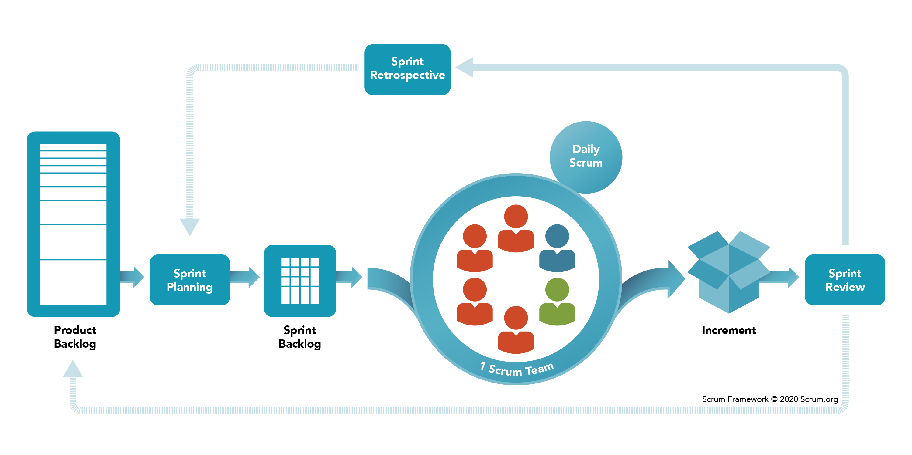
SCRUM Framework

Slide 30
SCRUM TERMINOLOGY
SCRUM Master
Product Owner
Developers (DevOps)
SCRM Events
Sprint
Sprint Planning
Daily Scrum
Sprint review
Sprint Retrospective

Slide 31
SCRUM Artefacts
Product Backlog
Product Backlog is an emergent, ordered list of what is needed to improve the product. It is the single source of work undertaken by the Scrum Team
Sprint Backlog
Sprint Backlog is composed of the Sprint Goal (why), the set of Product Backlog items selected for the Sprint (what), as well as an actionable plan for delivering the Increment (how).
Increment
Increment is a concrete stepping stone toward the Product Goal. Each Increment is additive to all prior Increments and thoroughly verified, ensuring that all Increments work together. In order to provide value, the Increment must be usable.

Slide 32
Kanban Framework
Kanban is a popular framework used to implement agile and DevOps software development. It requires real-time communication of capacity and full transparency of work. Work items are represented visually on a kanban board, allowing team members to see the state of every piece of work at any time.
A kanban board is an agile project management tool designed to help visualize work, limit work-in-progress, and maximize efficiency (or flow). It can help both agile and DevOps teams establish order in their daily work. Kanban boards use cards, columns, and continuous improvement to help technology and service teams commit to the right amount of work, and get it done!
Notes:
Kanban is similar to Scrum, in that it helps teams release software early and often. However, Kanban gives more flexibility in terms of planning and execution. Instead of working in time-based sprints, work is continuously delivered in Kanban, and your team pulls single pieces of work from the backlog, and then moves them to done.

Slide 33
Demo – Project Implementation

Slide 34
Review
What is SDLC?
Different methodologies
Agile Development
SCRUM
Kanban
Projects

Slide 35
THANK YOU

